Slide 1
Energy Consumption
By:
Anas Hany Kamal 19100081
Abdelrahman mohamed 1710030
Moayed Emad 18101245
Ahmed Hossam 19200095
Mohamad Hesham Abdelmegeed 202001337
Bola Nader202000645

Slide 2
Table of Content
- Problem definition.
- Used dataset
- Preparations & preprocessing
- Methods
- Results
- Conclusion

Slide 3
Problem Definition
Due to the industrialization boom in our modern society, energy consumption is constantly on the rise. Unfortunately, this consumption isn’t just measured in money value, but also in its environmental impact. The purpose of this project is to measure the energy consumed of different building categories in the modern day.

Slide 4
Used dataset
Our used data set was the one used in the ASHRAE - Great Energy Predictor III competition. This was due to that the dataset included one year of hourly meter readings from over one thousand buildings at several different sites. This dataset is divided to files which are the Train, Test, Building Meta, and Weather_[train/test].

Slide 5
Preparation
Through exploring the building metadata we have found that it contained 1449 rows. The year_build feature and floor_count feature had null percentages of 53% and 75%.
Through exploring the weather data we have found that the dataframe contained missing hours as well as null values.

Slide 6
KNN Imputer
To fill the null values in the floor count feature we have used the KNN imputer.
The null values were filled based on three features; Site_ID, Square_feet, Primary_use.
As the primary use feature is a categorical feature, we have used OneHotEncoding to encode this feature.
The rational behind this is based on the observation that buildings of similar area, primary use, and in proximity to each other tend to have similar attributes.

Slide 7
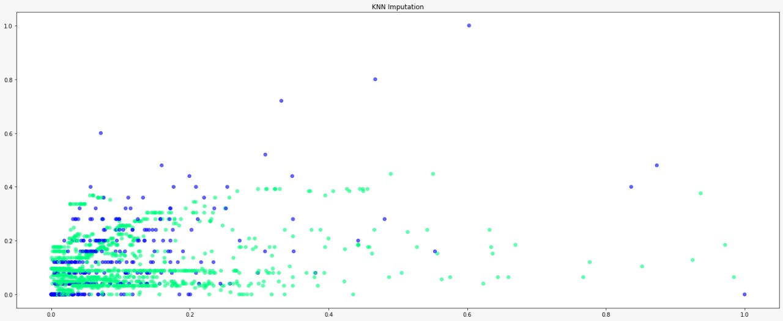
KNN Imputation Results

Slide 8
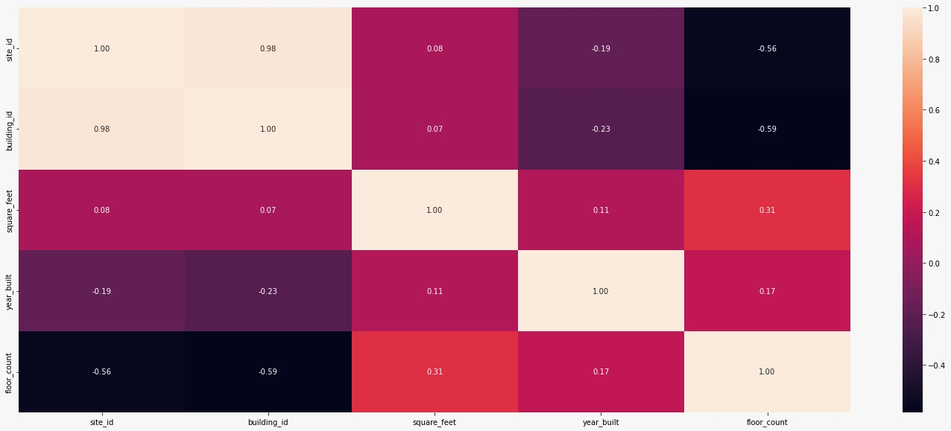
Exploring building metadata
Through exploring the correlations between the features between the data in the building metadata dataframe, it can be concluded that the problem in multicollinearity does exist in the dataframe.

Slide 9
Exploring the train dataframe
We have found that the train dataframe contains four columns which are building_ID, meter, timestamp, meter_reading.
The building_ID feature will be used to join the building metadata dataframe and the timestamp will be used to join the other dataframes.
The train dataframe had no null values.

Slide 10
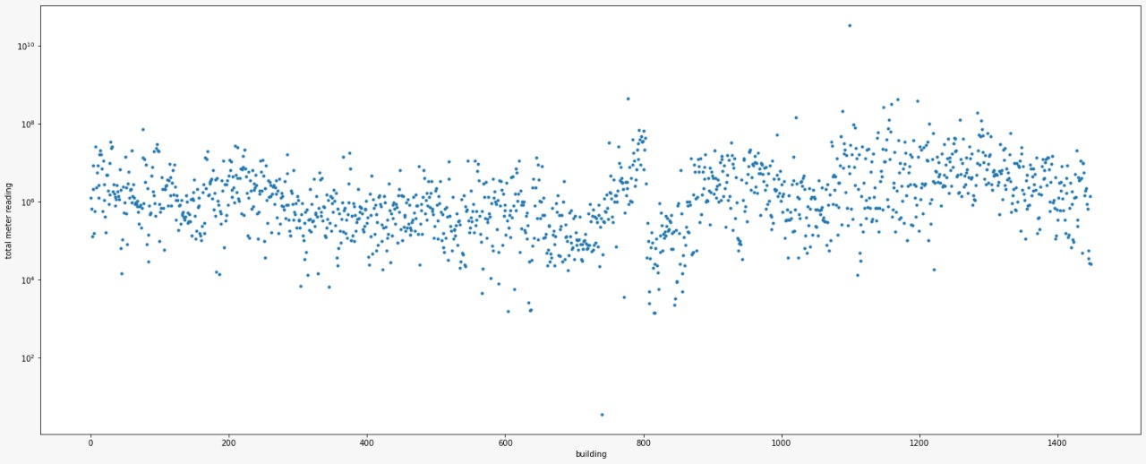
Further exploration
Through exploring the total meter readings of each building, we have found two very obvious outliers.

Slide 11
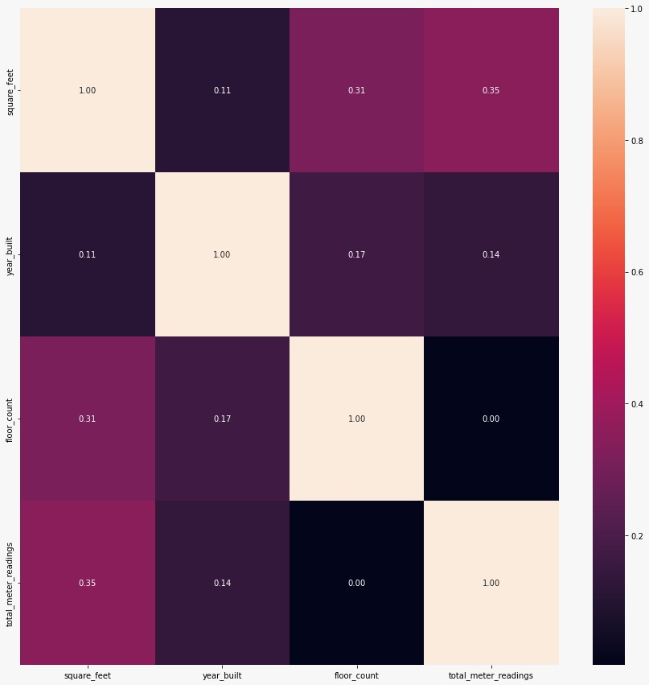
Exploring Correlations with target variable
From the heatmap, we have concluded that the floor count feature had absolutely zero correlations with the total meter reading , as well as the year build features had a very low correlation and an increased value of nulls.
Based on this we will be removing these two features before running the models.

Slide 12
Weather Data
As mentioned before, the weather dataframe had missing hours and null values.
As the weather data in nature are site specific, and do not change drastically between one hour and the next, the nulls and missing hours and the weather dataframe will be filled as follows:
Split the dataframe into several dataframes based on the Site ID
Determine which sites have missing hours
Fill the NULL values in each dataframe using interpolation
Stitch the dataframes back together to reform the weather dataframe
Finally we have stitched the weather dataframe, building metadata and the train dataframe together to form the final training dataset which will be used on the models.

Slide 13
Preparing for the models
To prepare for the models we have created a pipeline which consists of two pipelines that are numerical pipeline and the categorical pipeline
The categorical pipeline encodes the categorical data
the numerical pipeline scales the data through standard scaler

Slide 14
The ML models
The models we used were SGDRegressor, linear regression, and random forest regressor.
The best model was the random forest as the mean squared log error yielded 0.29 and the R^2 score was 0.82.
The SGDRegressor yielded an R^2 of 0.14 and a mean squared log error of 0.59
The Linear Regression Model yielded 0.58 for the mean squared log error and 0.17 for the R^2.

Slide 15
Thank you

